Slide 1

Data analytics
Skills build for colleges

Slide 2
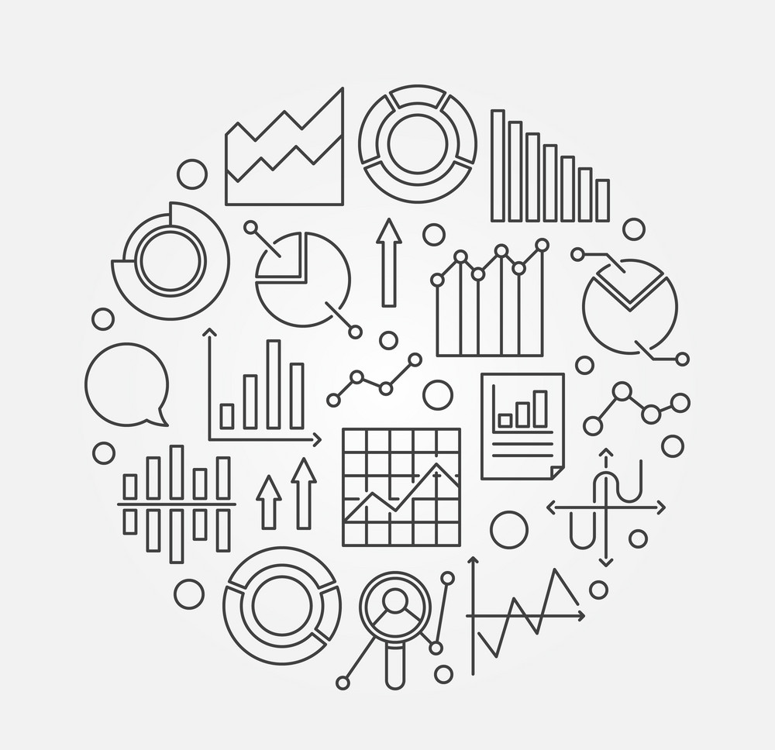
title
Definitions
What is data analytics
why data analytics is important to business?
Data Analytics Tools
Processes in data analytics
Data collections
ETL (Extract Transform LOAD)
The main four types of data analytics
Role of a data analyst
Career opportunities

Slide 3
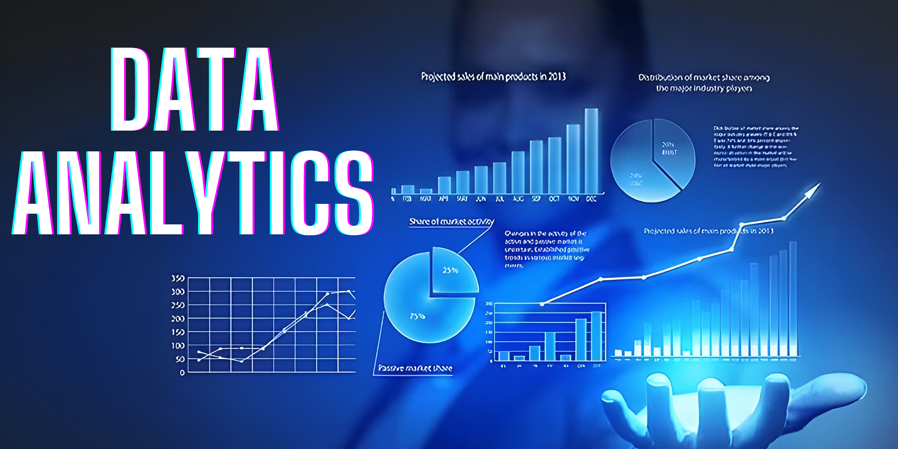
Data Analytics

Slide 4
Basic Definitions
Data : Data is a set of values of qualitative or quantitative variables. It is information in raw or unorganized form. It may be a fact, figure, characters, symbols etc.
Information: Meaningful or organized data is information.
Analytics : Analytics is the discovery , interpretation, and communication of meaningful patterns or summery in data.
Data Analytics :(DA) is the process of examining data sets in order to draw conclusion about the information it contains.
Analytics is not a tool or technology, rather it is the way of thinking and acting on data.
Notes:
Data:
Data is the raw material in its most basic form. It consists of unprocessed facts, figures, characters, symbols, or other raw values.
Data can be either qualitative or quantitative, which means it can represent qualities or quantities, such as text, numbers, images, or even sensor readings.
Data is typically unorganized and lacks context or meaning on its own. For example, a list of temperatures (e.g., 68°F, 72°F, 75°F) is data until it's organized or analyzed.
Information:
Information is derived from data when it is processed, organized, and given context, making it meaningful and useful.
It involves turning data into something that is actionable or can be used to make decisions. For instance, taking a set of temperature data and presenting it as the average temperature for the week (e.g., 71.67°F) is turning data into information.
Analytics:
Analytics refers to the process of discovering, interpreting, and communicating meaningful patterns or insights from data.
It involves examining data, finding trends, making predictions, and drawing conclusions based on the data.
Analytics can be performed using various techniques, including statistical analysis, machine learning, and data visualization.
Data Analytics (DA):
Data Analytics is a specific field that focuses on the systematic examination of data sets to extract valuable insights, discover trends, and draw conclusions.
It involves a range of techniques and methods, from basic statistical analysis to more advanced machine learning algorithms.
The goal of data analytics is to transform data into actionable information that can be used for decision-making, problem-solving, and improving processes.

Slide 5

What is data analytics?
Data analytics is the process of analyzing raw data in order to draw out meaningful, actionable insights, which are then used to inform and drive smart business decisions.
Notes:
Data analytics is a critical discipline that involves the systematic examination and interpretation of data to extract meaningful insights and guide decision-making.
It encompasses a series of processes, from data collection and cleaning to advanced statistical analysis and machine learning techniques.
By applying data analytics, organizations can uncover hidden patterns, trends, and correlations within their data, which in turn empowers them to make informed decisions, optimize processes, predict future outcomes, and gain a competitive edge in various industries.
Data analytics is not limited to business; it finds applications in healthcare, finance, marketing, and many other fields, driving innovation and efficiency by transforming raw data into actionable knowledge.

Slide 6

why data analytics is important to business?
Gain greater insight into target markets
Enhance decision-making capabilities
Create targeted strategies and marketing campaigns
Improve operational inefficiencies and minimize risk
Identify new product and service opportunities
Notes:
Gain Greater Insight into Target Markets: Data analytics allows businesses to dig deep into their customer data, helping them understand customer behavior, preferences, and demographics. This insight enables companies to tailor their products and services to better meet customer needs and preferences, resulting in increased customer satisfaction and loyalty.
Enhance Decision-Making Capabilities: With data analytics, businesses can make informed decisions based on data-driven insights rather than relying solely on intuition or guesswork. This leads to more effective and efficient decision-making, reducing the risks associated with gut-based decisions.
Create Targeted Strategies and Marketing Campaigns: By analyzing customer data and market trends, businesses can create highly targeted marketing strategies and campaigns. This not only saves resources by avoiding wasteful, broad advertising but also ensures that marketing efforts reach the right audience at the right time, increasing the chances of successful conversions.
Improve Operational Efficiencies and Minimize Risk: Data analytics can be applied to internal processes, helping businesses identify inefficiencies and areas for improvement. This can lead to cost savings, streamlined operations, and reduced operational risks.
Identify New Product and Service Opportunities: Data analytics can reveal untapped market opportunities by identifying gaps in the market or unmet customer needs. By understanding customer preferences and behavior, businesses can innovate and develop new products and services that are more likely to succeed in the marketplace.
References: 5 key reasons why data analytics is important to business | Penn LPS Online (upenn.edu)

Slide 7

Data Analytics Tools
Python – This object-oriented open-source programming language is used for manipulating, visualizing, and modelling data.
R – An open-source programming language used in numerical and statistical analysis.
Tableau – This helps in creating several kinds of visualizations for presenting insights and trends in a better way.
Power BI – This is a business intelligence tool that supports multiple data sources, helps in asking questions and getting immediate insights.
SAS – This statistical analysis software helps in performing analytics, visualizing data, writing SQL queries, performing statistical analysis, and building ML models.
Notes:
Each of these tools has its strengths and is chosen based on specific project requirements and individual preferences.
Python and R are popular choices for their flexibility and extensive libraries.
Tableau and Power BI excel in data visualization and reporting, while SAS is known for its robust statistical analysis capabilities.
The choice of tool often depends on the specific needs and goals of the data analytics project.

Slide 8
Processes in data analytics
The data analytics practice encompasses many separate processes, which can comprise a data pipeline:
Collecting and ingesting the data
Categorizing the data into structured/unstructured forms, which might also define next actions
Managing the data, usually in databases, data lakes, and/or data warehouses
Storing the data in hot, warm, or cold storage
Performing ETL (extract, transform, load)
Analyzing the data to extract patterns, trends, and insights
Sharing the data to business users or consumers, often in a dashboard or via specific storage
Notes:
Collecting and Ingesting Data:
This is the initial step where data is gathered from various sources, which can include databases, APIs, IoT devices, web scraping, or manual data entry.
Data can be in different formats, such as raw files, logs, or streams, and it needs to be ingested into the analytics system for processing.
Categorizing Data:
Data is often categorized into structured and unstructured forms. Structured data is organized and follows a specific schema, while unstructured data lacks a predefined structure and may include text, images, or multimedia.
Categorization may also involve defining the next actions to be taken with the data, such as cleaning, transformation, or analysis.
Managing Data:
Data management involves storing and organizing the data. This can be done in databases, data lakes, or data warehouses. The choice depends on the type of data, its volume, and the specific use case.
Storing Data in Hot, Warm, or Cold Storage:
Data can be categorized based on its usage and access frequency. Hot storage is for frequently accessed and real-time data, warm storage is for less frequently accessed data, and cold storage is for archival or historical data.
Performing ETL (Extract, Transform, Load):
ETL is a critical process that extracts data from its source, transforms it into the desired format, and then loads it into the storage system.
Transformation may involve data cleaning, data enrichment, and reformatting to make the data suitable for analysis.
Analyzing Data:
Data analysis is the core of data analytics. This stage involves using various techniques, such as statistical analysis, machine learning, and data visualization, to extract patterns, trends, and valuable insights from the data.
Sharing Data:
The insights derived from data analysis are often shared with business users or consumers. This can be done through interactive dashboards, reports, or specific storage systems where stakeholders can access and interact with the data.
The data pipeline is a structured approach to managing and extracting value from data. It ensures that data is collected, processed, and analyzed effectively, leading to informed decision-making and improved business processes. This process can be iterative, with data continuously collected and analyzed to adapt to changing business needs and new data sources.

Slide 9
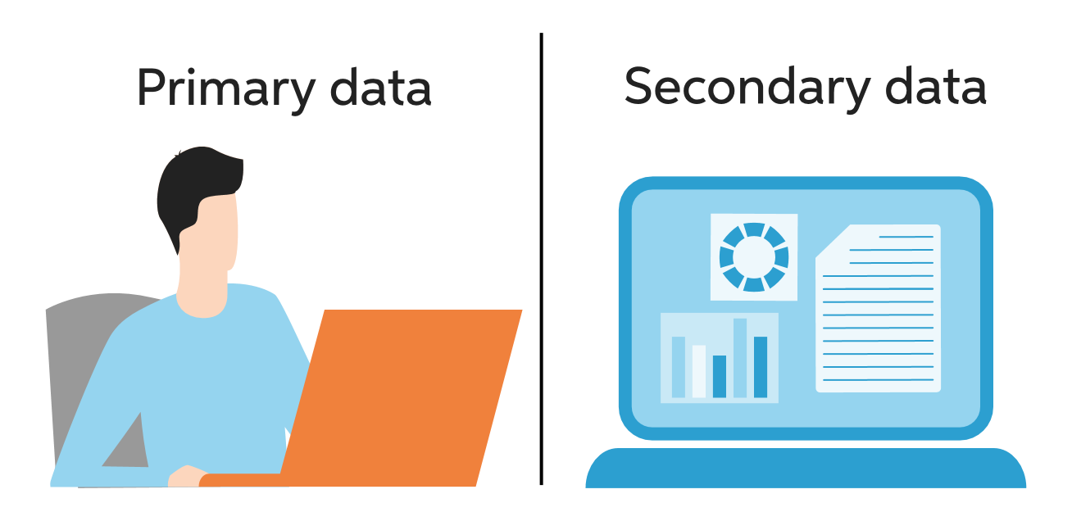
PRIMARY DATA AND SECONDARY DATA
1. Primary Data Collection:
Surveys and Questionnaires
Interviews
Observations
Experiments
Focus Groups
2. Secondary Data Collection:
Published Sources
Online Databases
Government and Institutional Records
Publicly Available Data
Past Research Studies
Primary data collection involves the collection of original data directly from the source or through direct interaction with the respondents.
Secondary data collection involves using existing data collected by someone else for a purpose different from the original intent.
Notes:
1. Primary Data Collection:
Primary data collection involves the collection of original data directly from the source or through direct interaction with the respondents. This method allows researchers to obtain firsthand information specifically tailored to their research objectives. There are various techniques for primary data collection, including:
a. Surveys and Questionnaires: Researchers design structured questionnaires or surveys to collect data from individuals or groups. These can be conducted through face-to-face interviews, telephone calls, mail, or online platforms.
b. Interviews: Interviews involve direct interaction between the researcher and the respondent. They can be conducted in person, over the phone, or through video conferencing. Interviews can be structured (with predefined questions), semi-structured (allowing flexibility), or unstructured (more conversational).
c. Observations: Researchers observe and record behaviors, actions, or events in their natural setting. This method is useful for gathering data on human behavior, interactions, or phenomena without direct intervention.
d. Experiments: Experimental studies involve the manipulation of variables to observe their impact on the outcome. Researchers control the conditions and collect data to draw conclusions about cause-and-effect relationships.
e. Focus Groups: Focus groups bring together a small group of individuals who discuss specific topics in a moderated setting. This method helps in understanding opinions, perceptions, and experiences shared by the participants.
2. Secondary Data Collection:
Secondary data collection involves using existing data collected by someone else for a purpose different from the original intent. Researchers analyze and interpret this data to extract relevant information. Secondary data can be obtained from various sources, including:
a. Published Sources: Researchers refer to books, academic journals, magazines, newspapers, government reports, and other published materials that contain relevant data.
b. Online Databases: Numerous online databases provide access to a wide range of secondary data, such as research articles, statistical information, economic data, and social surveys.
c. Government and Institutional Records: Government agencies, research institutions, and organizations often maintain databases or records that can be used for research purposes.
d. Publicly Available Data: Data shared by individuals, organizations, or communities on public platforms, websites, or social media can be accessed and utilized for research.
e. Past Research Studies: Previous research studies and their findings can serve as valuable secondary data sources. Researchers can review and analyze the data to gain insights or build upon existing knowledge.

Slide 10

ETL (Extract Transform LOAD)
Extract: Retrieve data from various sources, such as databases, files, or APIs.
Transform: Clean, filter, and manipulate data to ensure consistency and prepare it for analysis.
Load: Store the transformed data into a target system or data warehouse for easy access and analysis.
Notes:
ETL (Extract Transform Load)
Extract:
In the "Extract" phase, data is retrieved from various sources, which can include databases, flat files, APIs (Application Programming Interfaces), web services, or other data repositories.
Data is extracted in its raw form, often including both structured and unstructured data, from these disparate sources.
Transform:
The "Transform" phase is where the extracted data is cleaned, filtered, and manipulated to ensure its quality, consistency, and suitability for analysis.
Data transformation includes tasks such as data cleaning (removing duplicates and errors), data enrichment (adding missing information), data aggregation, and data formatting to align data from different sources.
Transforming data may also involve the application of business rules, calculations, and other operations to make the data ready for analysis.
Load:
In the "Load" phase, the transformed data is stored in a target system or data warehouse. This system is often optimized for efficient data storage, indexing, and retrieval.
Loading data into a centralized data repository makes it readily accessible for analysis, reporting, and business intelligence purposes.
Data in the data warehouse is typically structured, indexed, and optimized for quick query and reporting.
The ETL process is critical for ensuring that data is clean, consistent, and well-organized, making it suitable for analysis and decision-making. ETL pipelines can be automated and scheduled to run at regular intervals to keep the data warehouse up-to-date with the latest information from various source systems. This process is essential for organizations that rely on accurate and timely data for their operations and analytics.
Regenerate

Slide 11
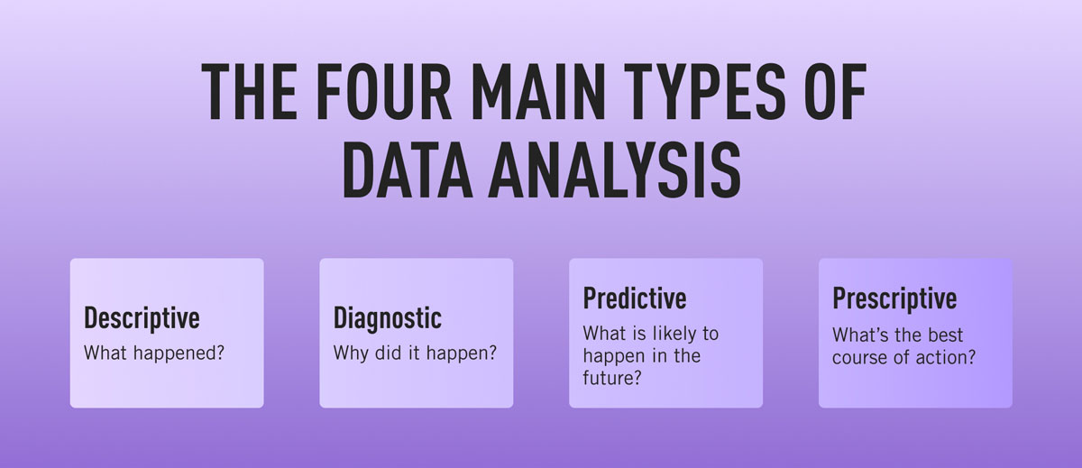
Types of data analytics?
Notes:
Descriptive Analytics: It tells you what happened in the past. It summarizes and visualizes historical data.
Diagnostic Analytics: It explains why something happened in the past. It helps you understand the causes of past events.
Predictive Analytics: It forecasts what might happen in the future. It uses data and models to make predictions.
Prescriptive Analytics: It not only predicts future events but also suggests what you should do to achieve the best outcomes. It provides actionable recommendations.

Slide 12
Diagnostic Analytics
Definition: Diagnostic analytics aims to determine the root causes and reasons behind certain events or trends observed in the data.
Key Characteristics: Involves data exploration, drill-down analysis, and correlation identification. Diagnostic analytics answers the question of "why did it happen."
Examples: Data mining techniques, regression analysis, cohort analysis.
Notes:
Diagnostic Analytics:
Diagnostic analytics delves deeper into data to understand why certain events or trends occurred. It focuses on identifying the root causes of past outcomes.
It involves investigating patterns and anomalies in historical data to provide explanations for observed behavior.
Diagnostic analytics is valuable for problem-solving and root cause analysis, helping organizations understand the reasons behind certain events or issues

Slide 13
Descriptive Analytics
Definition: Descriptive analytics focuses on summarizing historical data to gain insights into past events and understand the current state.
Key Characteristics: Involves data aggregation, visualization, and reporting. Descriptive analytics answers the questions of "what happened" and "what is happening."
Examples: Bar charts, line graphs, dashboards displaying key performance indicators (KPIs).
Notes:
Descriptive Analytics:
Descriptive analytics is the simplest form of data analytics. It involves summarizing historical data to gain insights into what has happened in the past.
This type of analytics uses techniques like data aggregation, data visualization, and basic statistical analysis to provide a clear picture of past events and trends.
It's often used for reporting and dashboarding to understand historical performance and make data-driven decisions based on that information.

Slide 14
Predictive Analytics
Definition: Predictive analytics leverages historical data to make predictions about future outcomes or events.
Key Characteristics: Involves statistical modeling, machine learning algorithms, and pattern recognition. Predictive analytics answers the question of "what is likely to happen."
Examples: Forecasting models, time series analysis, classification algorithms.
Notes:
Predictive Analytics:
Predictive analytics involves using historical data and statistical algorithms to make predictions about future events or trends.
This type of analytics is used to forecast outcomes, such as customer behavior, sales trends, equipment failures, or market demand.
Predictive analytics relies on techniques like regression analysis, machine learning, and time series forecasting to provide valuable insights for proactive decision-making.

Slide 15
Prescriptive Analytics
Definition: Prescriptive analytics recommends the best course of action based on predictive models, optimization techniques, and business rules.
Key Characteristics: Involves simulation, optimization algorithms, and decision support systems. Prescriptive analytics answers the question of "what should be done."
Examples: Optimization models, simulation tools, decision support systems.
Notes:
Prescriptive Analytics:
Prescriptive analytics is the most advanced form of data analytics. It not only predicts future events but also suggests actions or strategies to optimize outcomes.
It takes into account constraints, objectives, and various "what-if" scenarios to recommend the best course of action.
Prescriptive analytics is used in complex decision-making processes, such as supply chain optimization, resource allocation, and strategic planning.

Slide 16
Role of a data analyst
A data analyst role is to answer specific questions or address particular challenges that have already been identified and are known to the business.
To do this, they examine large datasets with the goal of identifying trends and patterns. They then “visualize” their findings in the form of charts, graphs, and dashboards.
Notes:
Data analysts play a pivotal role in helping organizations make informed decisions, improve processes, and gain a competitive edge by harnessing the power of data. They bridge the gap between raw data and actionable insights, supporting better decision-making at all levels of the organization.
The top 5 roles of a data analyst are:
Data Collection: Gathering data from various sources.
Data Cleaning: Making sure data is accurate and error-free.
Data Analysis: Finding patterns and insights in the data.
Data Visualization: Creating charts and graphs to present findings.
Reporting: Summarizing results and sharing them with others.

Slide 17
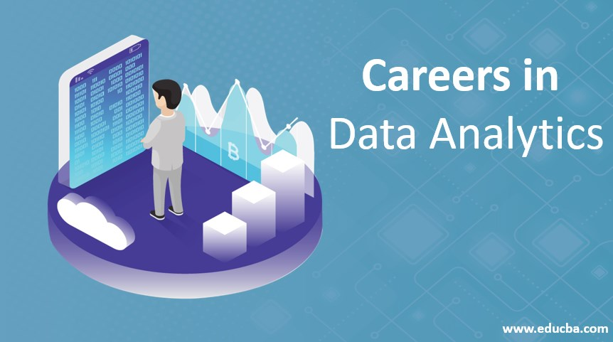
Career opportunities
1. Data Scientist
2. Business Intelligence Analyst
3. Data Engineer
4. Business Analyst
5. Marketing Analytics Manager
6. Financial Analyst
7. Quantitative Analyst
8. Risk Analyst
9. Data Governance Analyst
10. Data Visualization Engineer
Notes:
These careers offer diverse opportunities in terms of industries, specializations, and responsibilities. The demand for data professionals continues to grow across multiple sectors as organizations recognize the value of data-driven decision-making and optimization.
References: The Top 10 Data Analytics Careers: Skills, Salaries & Career Prospects | DataCamp

Slide 18
Steps involved in data analytics.
Gather the required dataset
Understand the dataset
Clean the dataset
Do the necessary statistical analysis
Plot the necessary visualizations to draw out meaningful, actionable insights from the data.
Notes:
Collect Data: Gather the data you need from various sources, like databases or spreadsheets.
Clean Data: Remove errors and make sure the data is accurate and consistent.
Explore Data: Look at the data to find patterns and trends.
Analyze Data: Use math and statistics to draw insights from the data.
Visualize Data: Create charts and graphs to make the insights easy to understand.
Interpret Data: Understand what the data is telling you.
Report Findings: Share the insights with others in a clear and simple way.

Slide 19
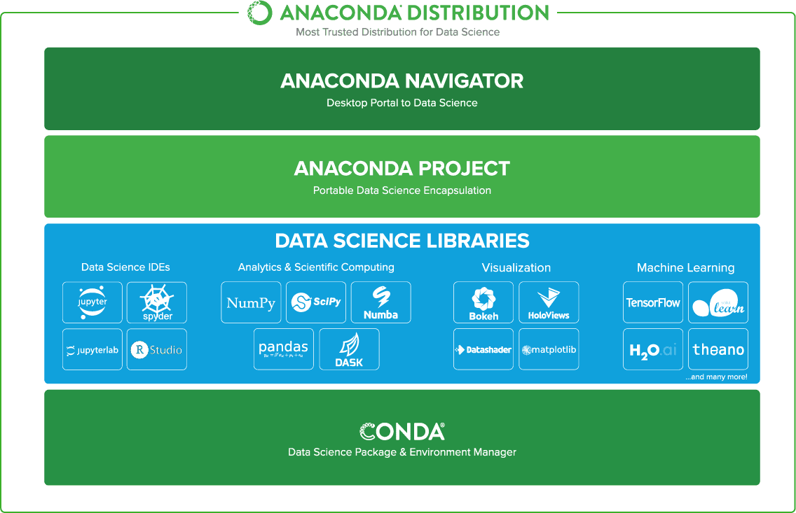
ABOUT ANACONDA NAVIGATOR
Notes:
Anaconda Navigator is a user-friendly tool that simplifies the process of managing data analysis software, libraries, and projects.
It provides a graphical interface for data analysts and scientists to easily install, organize, and work with the tools and packages needed for data analysis.
It's a helpful tool for those involved in data analytics, as it streamlines the setup and management of data-related environments and projects, making it more accessible for both beginners and experienced professionals in the field.

Slide 20
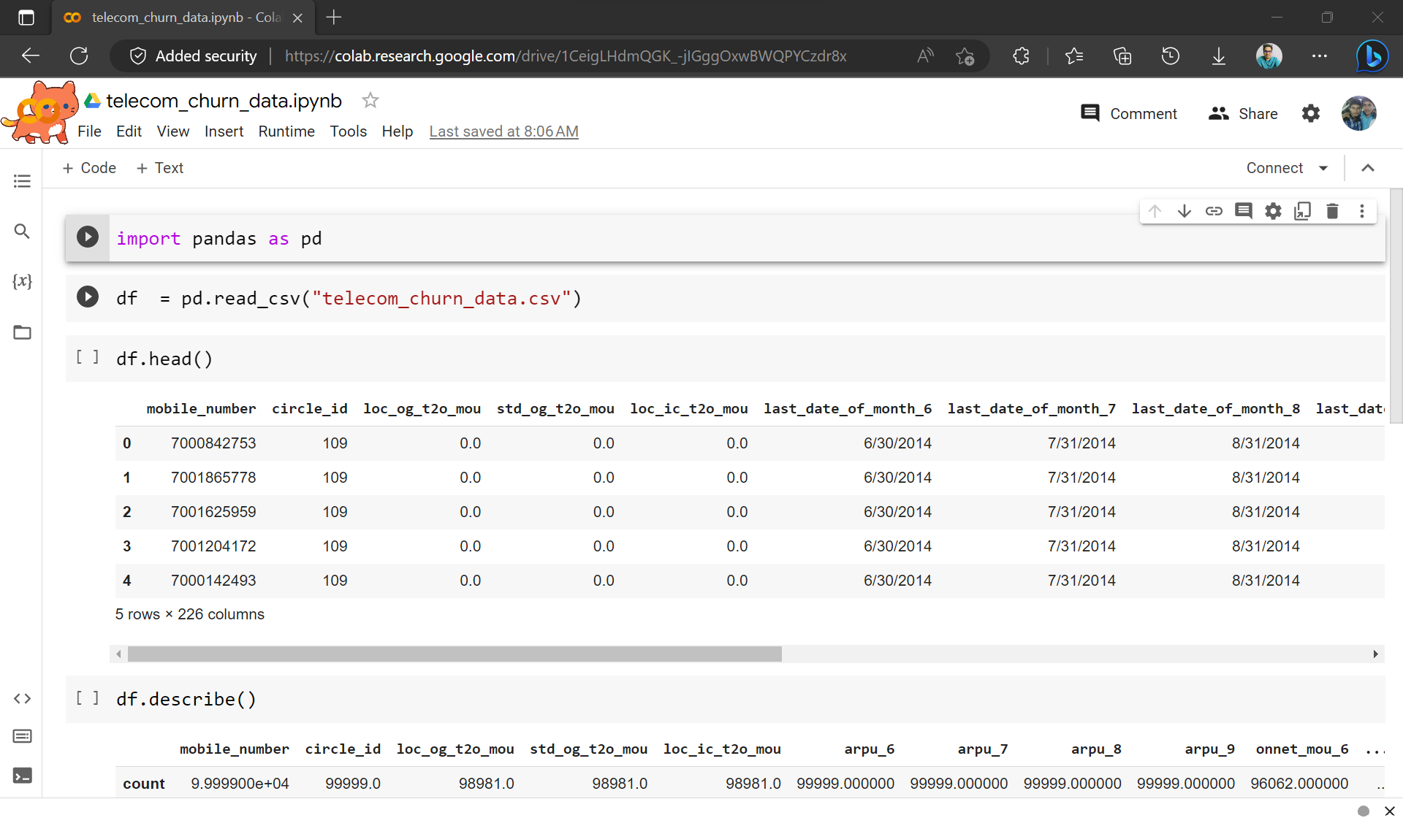
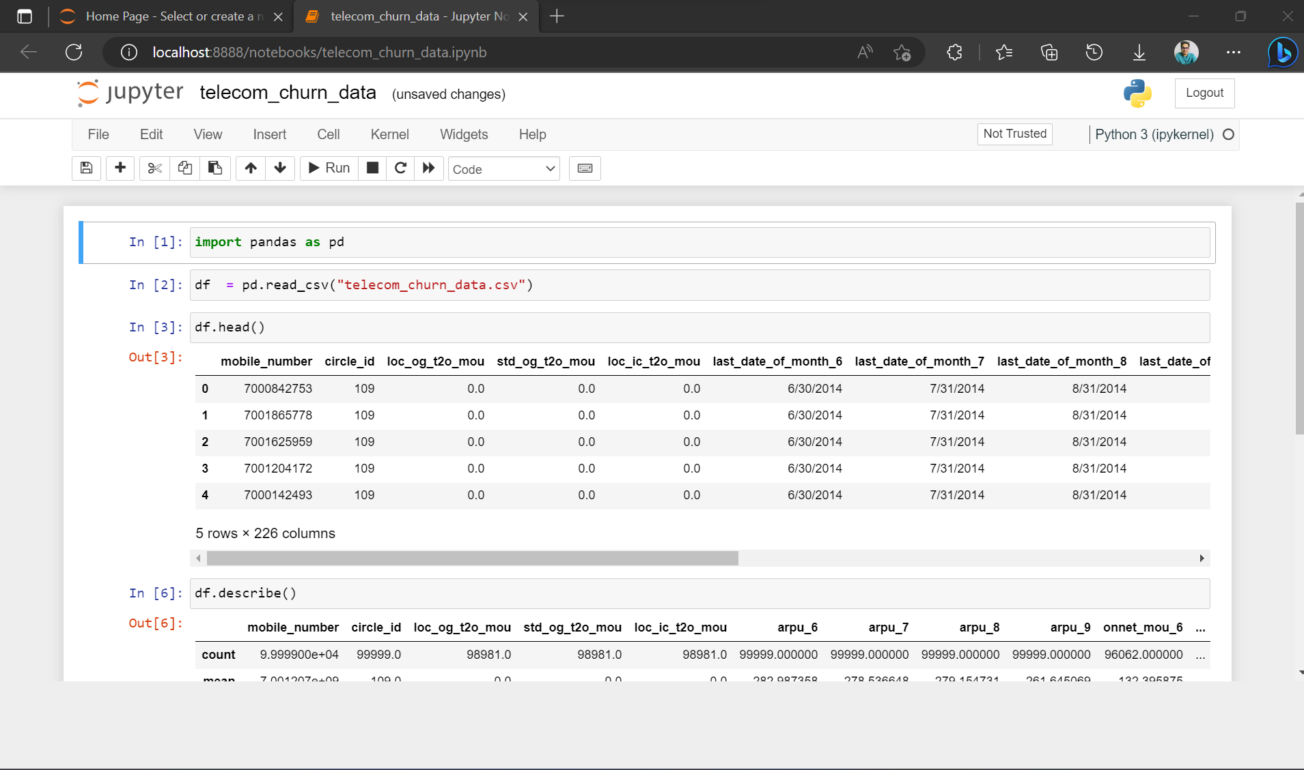
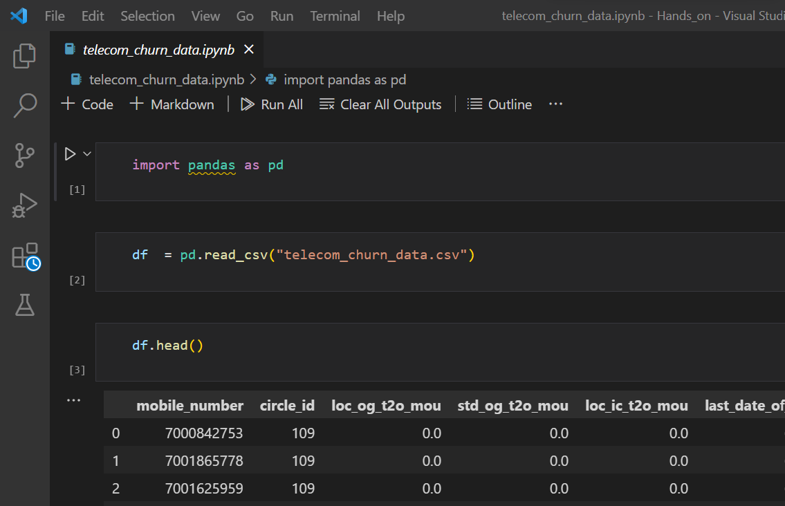
Platforms that we are going to use.
Google Colab
Jupyter Notebook
Visual studio code
Notes:
For data analysis we are going to use thes basic platforms which are very convenient for analysis.
Google colab : free platform provided by google which allows us to use GPU and TPU in free of cost.
Which provides speed up while doing analysis on large data. Only the requirement is internet.
Jupyter notebook: it’s a offline platform which alows to run the code blockwise.
Visual studio code: we can use vs code also by using extension .ipynb

Slide 21

Introduction to Pandas
Pandas is an open-source, BSD-licensed Python library providing high-performance, easy-to-use data structures and data analysis tools for the Python programming language.
Pandas is built on top of NumPy library.
Pandas is well suited for many different of data
Image Source: https://realpython.com/pandas-dataframe/
Notes:
pandas is an open-source, BSD-licensed Python library providing high-performance, easy-to-use data structures and data analysis tools for the Python programming language.
pandas is built on top of NumPy library.
pandas is well suited for many different of data:
Tabular data with heterogeneously-typed columns, as in an SQL table or Excel spreadsheet
Ordered and unordered (not necessarily fixed-frequency) time series data.
Arbitrary matrix data (homogeneously typed or heterogeneous) with row and column labels
Any other form of observational / statistical data sets. The data actually need not be labeled at all to be placed into a pandas data structure

Slide 22
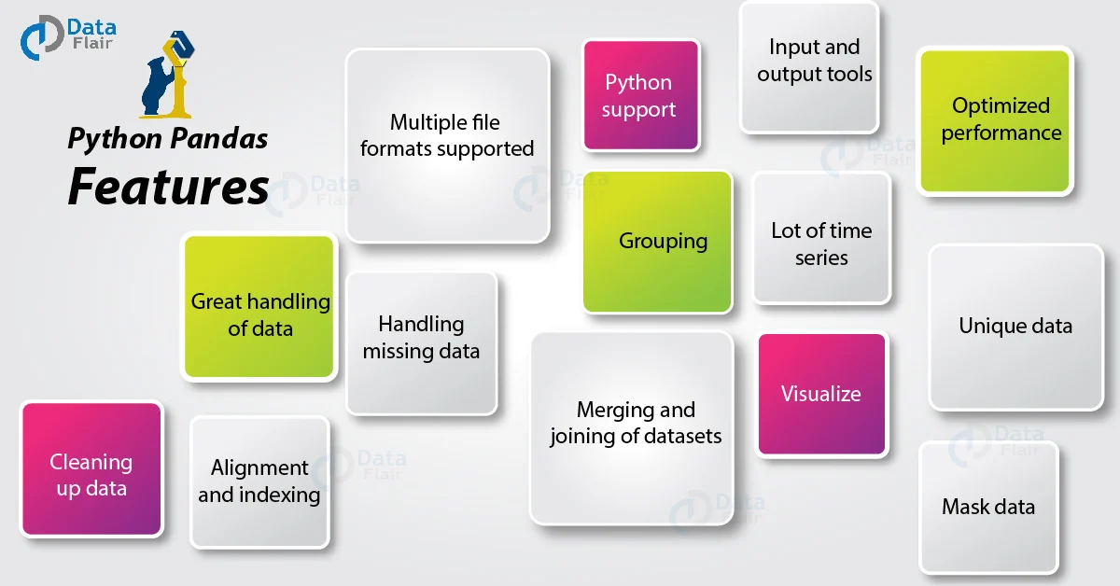
Features of Pandas
Image Source: https://data-flair.training/blogs/python-pandas-features/
Notes:
This slide deals with the features of Pandas:
The key characteristics of Pandas are:
We can import, prepare, modify, model, and analyze data with Pandas, regardless of its origin.
With default and customizable indexing, the Data Frame object is quick and efficient.
Tools for loading data from various file formats into in-memory data objects.
Data alignment and handling of missing data in a unified manner.
Date sets can be reshaped and pivoted.
Slicing, indexing, and sub setting of big data sets depending on labels.
A data structure's columns can be removed or added.
For aggregation and transformations of data, group by function is used .
Data merging and joining with high performance.
Time Series based functionality is one the useful feature of Pandas

Slide 23
Most used functions in Pandas
read_csv()
head() /head(n)
describe()
memory_usage()
astype()
loc[:]
to_datetime()
value_counts()
drop_duplicates()
groupby()
merge()
sort_values()
fillna()
Notes:
As we discussed Pandas is a library that deals with data and it consist of functions that can handle data
Most commonly used thirteen functions of pandas and its uses are explained here
read_csv() function helps read a comma-separated values (csv) file into a Pandas DataFrame.
head(n) is used to return the first n rows of a dataset. By default, head() will return the first 5 rows of the DataFrame.
describe() is a Pandas DataFrame or Series function that generates descriptive statistics for the data. It describes the dataset's central tendency and dispersion. describe() is useful for quickly acquiring an overview of a dataset.
memory_usage() returns a Pandas Series having the memory usage of each column (in bytes) in a Pandas DataFrame.
The astype() function is used to convert a Python object to a certain data type. It can be a very useful feature if your data isn't saved in the right format.
loc[:] allows us to access a collection of rows and columns in a dataset, or a slice of the dataset, as needed.
to_datetime() is a Python function that transforms a Python object to datetime format.
value counts() produces a Pandas Series with unique value counts.
drop_duplicates() provides a Pandas DataFrame that is free of duplicate entries.
groupby() is a Pandas DataFrame function that groups data by one or more columns and performs a mathematical operation on it. The function groupby() can be used to quickly summarise data.
On a common column, merge() is used to join two Pandas DataFrame objects or a DataFrame and a Series object (field).
Sort columns in a Pandas DataFrame (or a Pandas Series) by values in ascending or descending order with sort values().
Several entries in a big dataset will typically be labelled NaN by Python.
The term "not a number" refers to items that were not filled out in the original data source.
Pandas ensures that these items may be identified independently by the user while populating the data in the DataFrame.
fillna() replaces all NaN values in a DataFrame or Series with more suitable values by imputing these missing values.

Slide 24
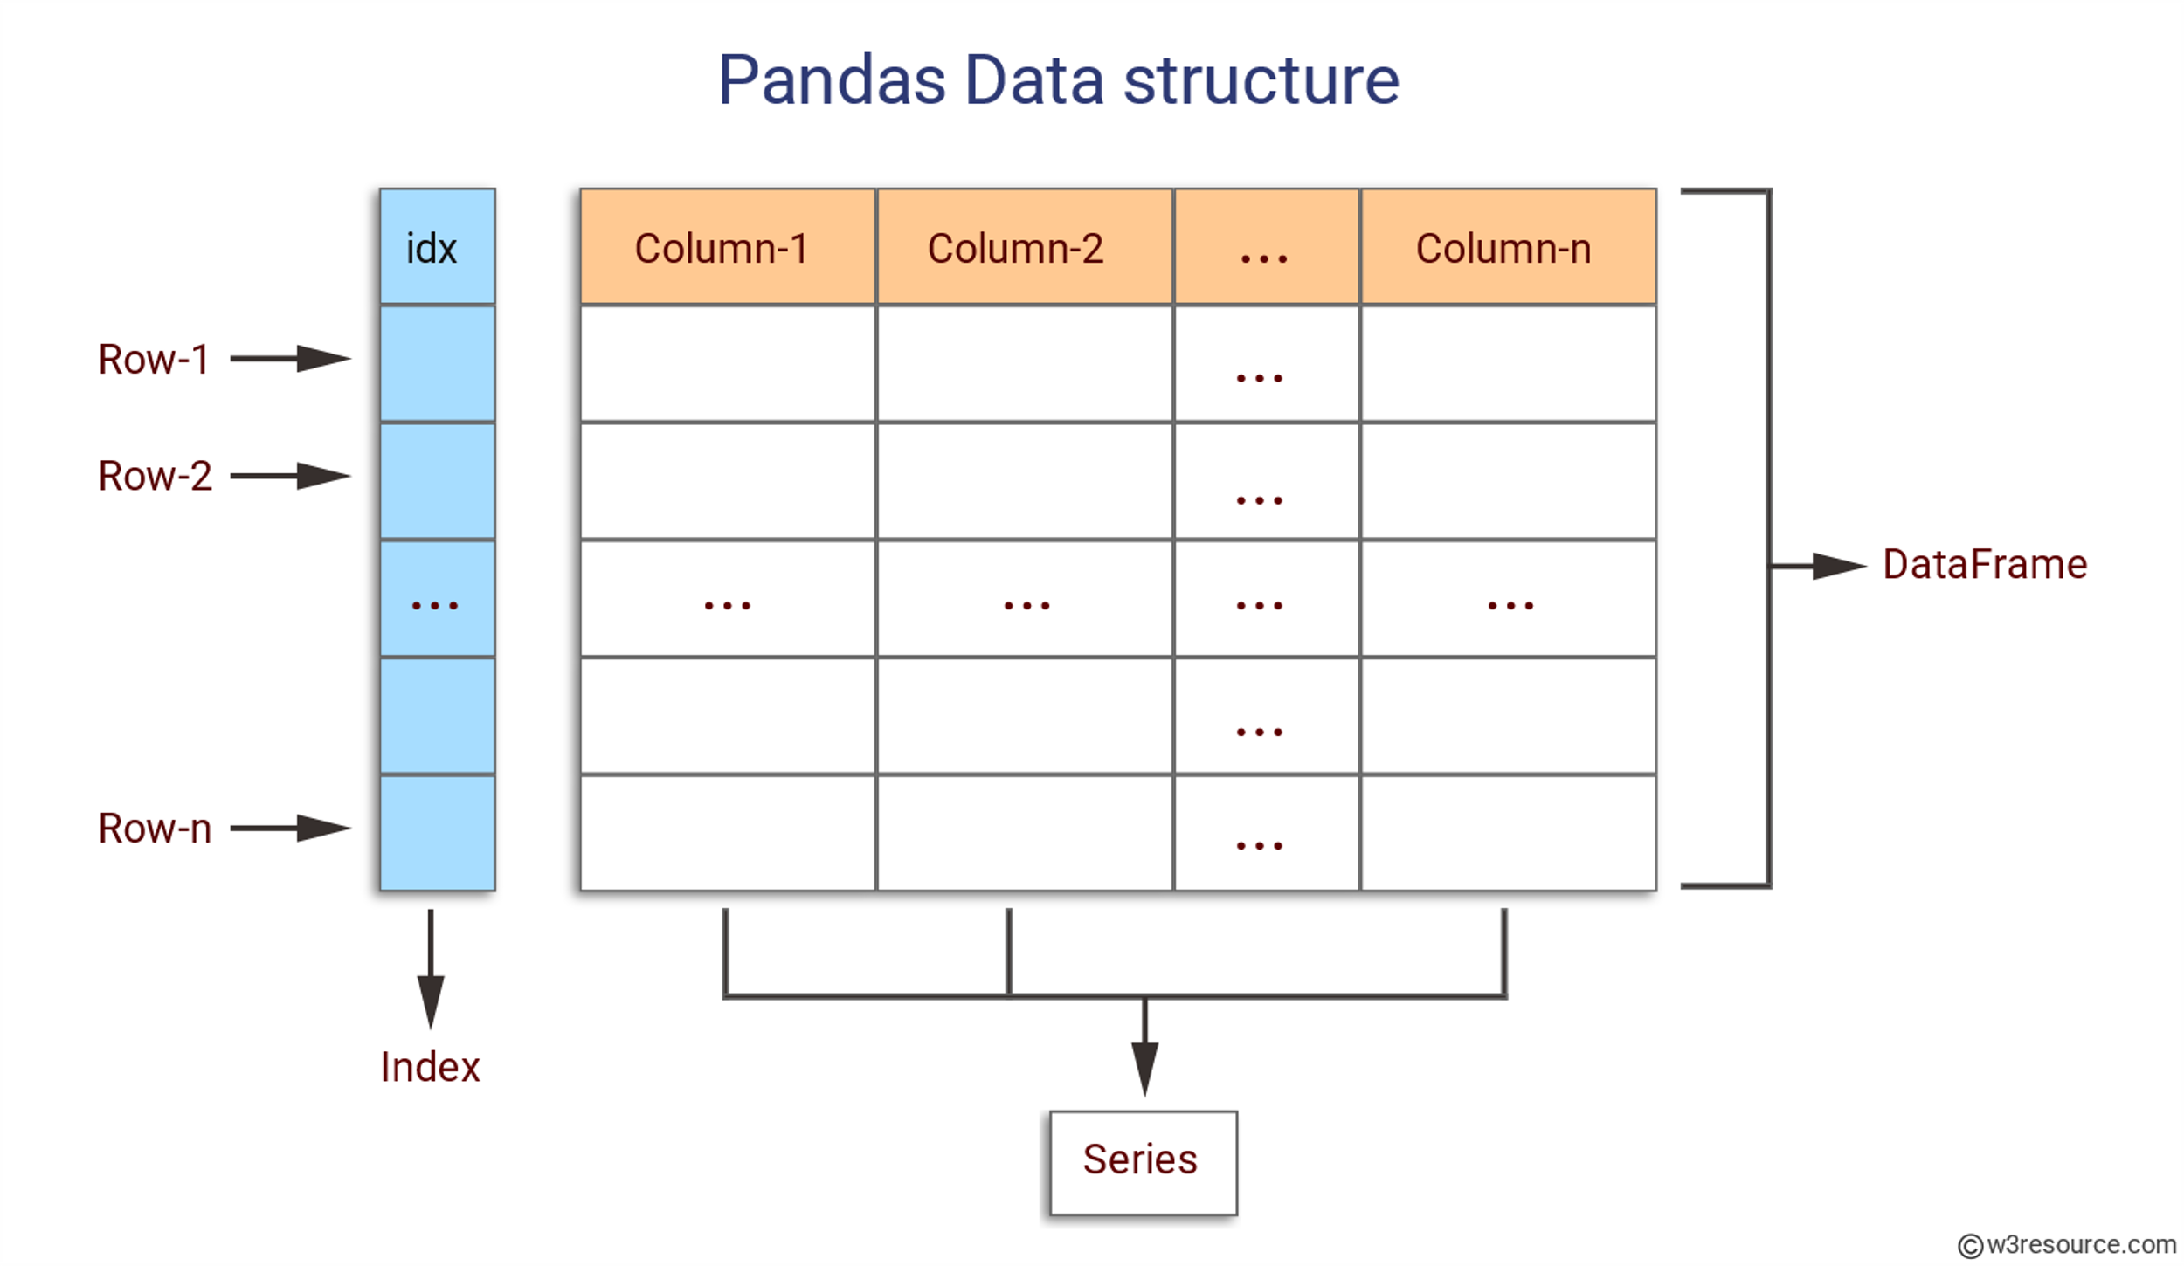
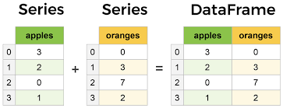
Core components of Pandas : Series and Data Frame
https://www.learndatasci.com/tutorials/python-pandas-tutorial-complete-introduction-for-beginners/
Notes:
The Series and DataFrame are the two most important parts of pandas.
A Series is a multi-dimensional table made up of a collection of Series, while a DataFrame is a multi-dimensional table made up of Series.
DataFrames are the Pandas data type for storing tabular 2D data, and Pandas is the most used data manipulation programme in Python.
The figure represents Pandas series and Data Frame.

Slide 25
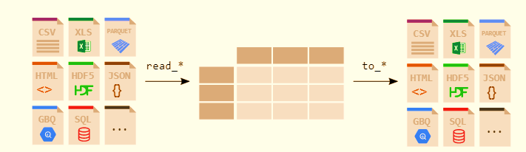
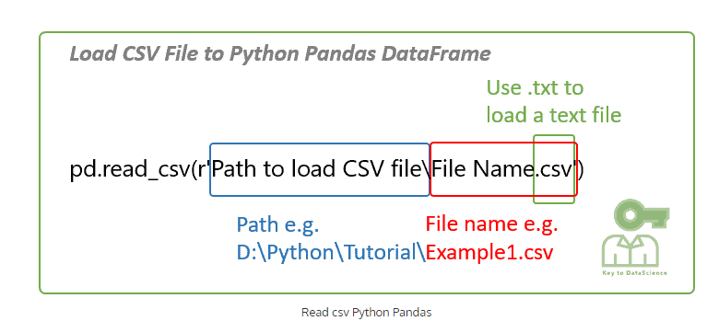
File Handling with Pandas
https://pandas.pydata.org/docs/getting_started/intro_tutorials/02_read_write.html
Notes:
Any analyst or data scientist should be able to read data from CSV files and write data to CSV files using Python.
The read_csv() method in pandas allows you to read data from a csv file into a pandas DataFrame.
Pandas comes with support for a variety of file formats and data sources (csv, excel, sql, json, parquet, and so on), all of which begin with the prefix read_*.

Slide 26
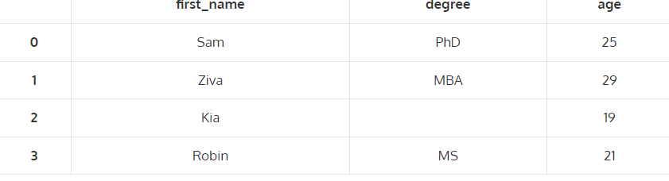
Sample Reading and writing .csv file
import pandas as pd
# Create a dataframe
raw_data = {'first_name': ['Sam','Ziva','Kia','Robin'],
'degree': ['PhD','MBA','','MS'],
'age': [25, 29, 19, 21]}
df = pd.DataFrame(raw_data)
df
#Save the dataframe
df.to_csv(r'Example1.csv')
import pandas as pd
# Read csv file
df = pd.read_csv(r'D:\Python\Tutorial\Example1.csv')
df
Output
Notes:
The sample code for reading and writing of CSV file is shown here
To read the csv file DataFrame you just created to a csv file, Enter the path and filename where the csv file is stored.
You may try this code in Jupyter notebook

Slide 27
Exploring a dataset using Pandas
Download the dataset from: https://drive.google.com/file/d/1q7qK03njlzZRQ7PyYoprn12uVnE1gjH6/view
Import pandas as pd
data_1 = pd.read_csv(r‘<datasetpath>')
data_1.head(6)
data_1.describe()
data_1.memory_usage(deep=True)
data_1['Gender'] = data_1.Gender.astype('category')
data_1.loc[0:4, ['Name', 'Age', 'State']]
data_1['DOB'] = pd.to_datetime(data_1['DOB'])
data_1['State'].value_counts()
data_1.drop_duplicates(inplace=True)
data_1.groupby(by='State').Salary.mean()
data_1.sort_values(by='Name', inplace=True)
data_1['City temp'].fillna(38.5, inplace=True)
Ref: https://www.analyticsvidhya.com/blog/2021/05/pandas-functions-13-most-important/
Notes:
Download the dataset from the link provided and explore the dataset using the popular functions in pandas
The dataset set path along with the csv file name should be specified in the space provided
You may try this in jupyter notebook
https://www.analyticsvidhya.com/blog/2021/05/pandas-functions-13-most-important/

Slide 28
Convert list into series of elements
# convert element lists into series of elements, which have index from 0—5
import pandas as pd
my_data=[10,20,30,40,50]
pd.Series(data=my_data)
Convert dictionary into series of elements
import numpy as np
import pandas as pd
d={'a':10,'b':20,'c':30,'d':40}
#dictionary keys act as index and values with every key act as series values
pd.Series(d)
Notes:
We can convert any list or dictionary in to a series which is also called as one dimensional array, using pd.series method.
Here in this method we can mention indexing also. If not mentioned if will take default indexing witch starts from zero.
While converting dictionary in to series the keys of dict will act as indexes and values will act as series elements.

Slide 29
Data Manipulation: Drop missing elements
import pandas as pd
import numpy as np
d={'A':[1,2,np.NaN], 'B':[1,np.NaN,np.NaN],'C':[1,2,3]}
# np.NaN is the missing element in DataFrame
df=pd.DataFrame(d) dictionary will get converted in to dataframe
df.dropna() #pandas would drop any row with missing value
df.dropna(axis=1) #drop column with NULL value
Notes:
The sample code for dropping missing values by dropping corresponding row or column is shown here
Here np.NaN is the missing element in DataFrame

Slide 30
Data Manipulation: Filling suitable value
df.fillna(value='FILL VALUE') #NaN is replaced by value=FILL VALUE
df['A'].fillna(value=df['A'].mean())
#Select column "A" and fill the missing value with mean value of the column A
df['A’].fillna(value=df['A’].std())
#Select column "A" and fill the missing value with standard deviation value of the column A
Notes:
The code shown here is to fill the missing value with a particular value or
by Selecting column "A" and fill the missing value with mean value of the column A or
By Selecting column "A" and fill the missing value with standard deviation value of the column A

Slide 31
Replacing a value
import pandas as pd
df = pd.DataFrame({'one':[10,20,30,40,50,2000], 'two':[1000,0,30,40,50,60]})
print df.replace({1000:10,2000:60})
Notes:
Many times, we have to replace a generic value with some specific value.
We can achieve this by applying the replace method.
Replacing NA with a scalar value is equivalent behavior of the fillna() function.
In this case 1000 is replaced with 10 and 2000 is replaced with 60 using replace method.

Slide 32
Groupby() function
data = {'Company’: [ ‘CompA’, ‘CompA’, ‘CompB’, ‘CompB’, ‘CompC’, ‘CompC’],
'Person’: [‘Rajesh’, ‘Pradeep’, ‘Amit’, ‘Rakesh’, ‘Suresh’, ‘Raj’],
'Sales’: [200, 120, 340, 124, 243, 350]}
df=pd.DataFrame(data)
df
comp=df.groupby("Company").mean()
comp
comp1=df.groupby("Company") #grouping done using label name “Company”
comp1.std() #apply standard deviation on grouped data
Notes:
The groupby() function divides data into groups depending on a set of criteria.
Any of the axes can be used to separate pandas objects. Grouping is defined as a mapping of labels to group names in its most basic form.
In the code provided here, grouping based on company name and applying statistics like Mean or standard deviation to the grouped data is performed.

Slide 33
Finding maximum value in each label
data = {'Company’: [ ‘CompA’, ‘CompA’, ‘CompB’, ‘CompB’, ‘CompC’, ‘CompC’],
'Person’: [‘Rajesh’, ‘Pradeep’, ‘Amit’, ‘Rakesh’, ‘Suresh’, ‘Raj’],
'Sales’: [200, 120, 340, 124, 243, 350]}
df=pd.DataFrame(data)
df
df.groupby("Company").max()
Notes:
Here the dataset is grouped based on ‘company’ label and pick maximum value in each label

Slide 34
Finding unique value & number of occurrence from Dataframe
df = pd.DataFrame({'col1':[1,2,3,4],'col2':[444,555,666,444],'col3':['abc','def','ghi','xyz’]})
# col1, col2 & col3 are column labels, each column have their own values
df['col2'].unique() #fetches the unique values available in column
df['col2'].value_counts() # count number of occurrence of every value
Notes:
The code provided here:
fetches the unique values available in column 2
count number of occurrence of every value in column 2

Slide 35
Statistical Functions
import numpy as np
import pandas as pd
s = pd.Series([1,2,3,4,5,4])
print s.pct_change()
df = pd.DataFrame(np.random.randn(5, 2))
print df.pct_change()
s1 = pd.Series(np.random.randn(10))
s2 = pd.Series(np.random.randn(10))
print s1.cov(s2) import numpy as np
frame = pd.DataFrame(np.random.randn(10, 5), columns=['a', 'b', 'c', 'd', 'e'])
print frame['a'].corr(frame['b'])
print frame.corr()
s = pd.Series(np.random.randn(5), index=list('abcde'))
s['d'] = s['b'] # so there's a tie
print s
print s.rank()
Notes:
The code provided here is to perform certain statistical functions explained as follows:
The pct_change() function compares every element with its prior element and computes the change percentage.
Covariance is applied on series data. The Series object has a method cov() to compute covariance between series objects. NA will be excluded automatically.
Correlation shows the linear relationship between any two array of values, available in series.
There are multiple methods to compute the correlation like pearson(default), spearman and kendall
Data Ranking produces ranking for each element in the array of elements; ;arge value assigned higher rank.
In case of ties, assigns the mean rank.

Slide 36


